Slide 1
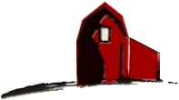
Introduction to 3D Printing
Bainbridge Artisan Resource Network
Electronic & Technical Arts Studio

Slide 2
Objectives
Learn what 3D printing is and how it works
During class …
Acquire a 3D model to print
Prepare the model to be printed
Print it
After class …
Be able to become certified to use BARN’s 3D printing facilities on your own
Learn more advance techniques either through additional BARN classes or through self-guided learning (YouTube, et al.)

Slide 3
Agenda
3D Printing … what it is and what it is not
Workflow ... from model to finished print
Preparing the model to be printed
Loading the file, setting-up the printer, starting the print
The finished results
Additional Topics
Finding and downloading a model
Creating a model from scratch (superficially covered)

Slide 4
What is 3D Printing?
An Additive Manufacturing process
Material is added in layers
Wide variety of materials: plastics, metals, glass, ceramic, food, …
Printed through a variety of processes: heat, lasers, ultraviolet, …
At the bleeding edge: printed organs, exotic food presentation, prosthetics … limited only by imagination.
At BARN, 3D printing is …
Melted plastics extruded through a heated nozzle (much like a glue gun)
Misconceptions and cautions
You can’t print everything
It may take some tweaking of printer settings
Size is limited
Prints can take a long time

Slide 5
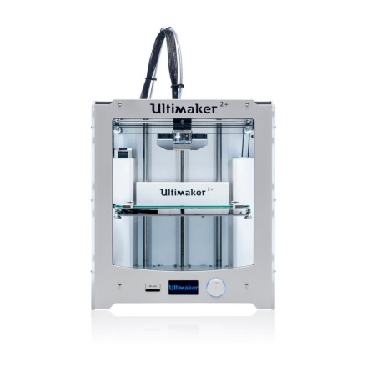
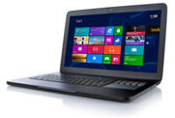
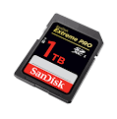
3D Printer Workflow at BARN
Internet Sources
Your Computer
Ultimaker 2+
Download
Slice
.stl
model
Cura
. gcode sliced model
SD Card
Design
3D Design App

Slide 6
Prepare 3D Model for Printing
Internet Sources
Your Computer
Ultimaker 2+
Download
Slice
.stl
model
Cura
. gcode
sliced model
Prepare 3D model
SD Card
Design
3D Design App

Slide 7
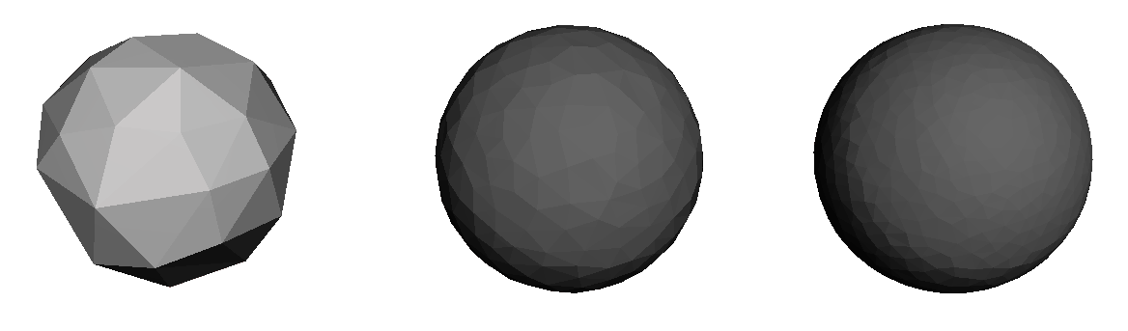
The model file
Computer generated file
.stl file type (stereolithography)
Almost universally used at BARN and elsewhere
Defines the surface geometry
Surface is defined by linked triangles
Following is an .stl example of a sphere in different resolutions

Slide 8
The Sliced Model
Computer generated file
.gcode file type
File format support a layer-by-layer manfacturing process
Originally for subtractive manufacturing (e.g., CNC Routing/Machining)
gcode for 3D printing is a derivative of the original gcode
Defines how the printer should behave
Horizontally slices the model into layers
For each layer, it defines print-head movement and actions

Slide 9

Slicing The Model
A software program to converts the 3D model (.stl) into a printable model (.gcode)
It specifies things like layer height, speeds, infill density
There are lots of different slicer programs.
Cura, Slic3r, MatterControl, KISSicer
At BARN with the Ultimaker2+, we use Cura
.stl model defines the surface geometry
Cura creates a layer-by -layer definition
.gcode controls each level of the printing process

Slide 10
Slicing The Model
Cura needs to know about …
Printer and the nozzle being used
Material being used
We will focus on basic settings
Nozzle size (0.4 mm) > preset and OK
Material (typically SLA) > you set
Profile (predefined settings) > you set
High Quality +++ quality print time: 3x Fast setting
Normal Quality ++ quality print time: 2x Fast setting
Fast Print + quality print time: fastest
These settings work for the majority prints

Slide 11
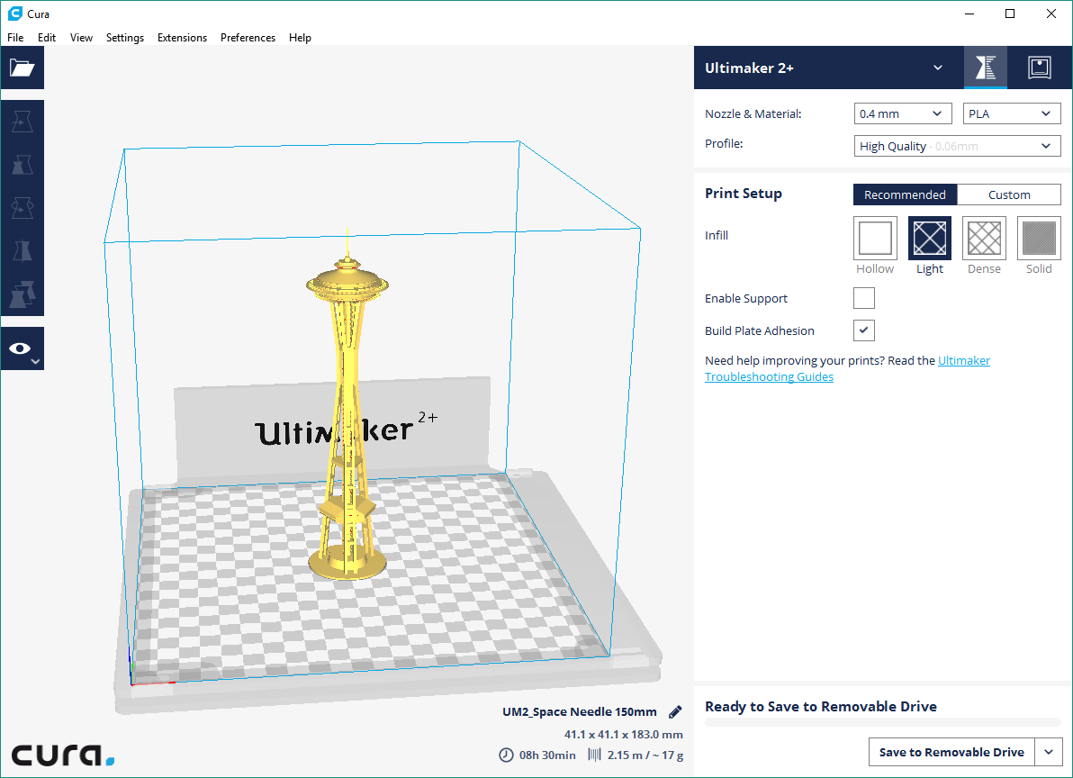
Using Cura
File Name
Size
Print Time

Slide 12
Using Cura
Model maximums
Maximum size is 223 x 223 x 205 mm (8.8 x 8.8 x 8.1 inches)
BUT the time to print this would be measured in days
Additional resources
Cura manual:
Learning Cura

Slide 13
Printing the Model
Internet Sources
Your Computer
Ultimaker 2+
Print the model
Download
Slice
.stl
model
Cura
. gcode
sliced model
SD Card
Design
3D Design App

Slide 14
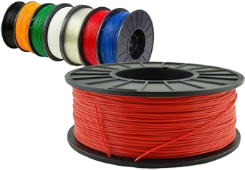
Material Used
Material is referred to as Filament
Wide range of material types to choose from
Three typical diameters
1.75 mm, 2.85 mm, 3.0 mm
Material type, diameter and other recommended printer settings are written on each spool
Note: The filament available for 3D printing at BARN has been provided by individual members of ETA. Unless a spool is otherwise marked, it is available to be used by a BARN member. If you plan to become active in 3D printing, please consider contributing a spool to the studio cache. You could replace a spool that is running low or add a new/novel color or material.

Slide 15
Material Used
PLA (polylactic acid) | The most widely used; recommended for beginners. Prints fast, is safe, can be used for a broad range of models and applications. (Most commonly used at BARN).
Nylon (polyamide) | Widely used by manufacturers for strong end-use parts and functional prototypes requiring durability and abrasion resistance.
ABS (acrylonitrile butadiene styrene) | Frequently used. Good mechanical properties; can be used for a wide range of applications. *Requires ventilation during printing.
CPE (co-polyester) | Chemical resistant, relatively tough material widely used for functional prototyping and modeling.
PVA (polyvinyl alcohol) | Used to create water soluble support structures to achieve complex geometries.
PC (polycarbonate) | Very strong and tough material used for various engineering applications.
TPU (thermoplastic polyurethane) | Semi-flexible; used in a wide variety of engineering projects where easier and faster printing is more important than aesthetic qualities.
More details at all3dp.com: 3D Printer Filament Guide & Comparison

Slide 16
Setup Printer
Load SD Card
tbd
Load Material
tbd

Slide 17
Setup Printer (continued)
Select and print model
tbd

Slide 18
The Finished Print
Tbd – discuss print fails (not in depth)

Slide 19
Find Existing 3D Models
Internet Sources
Your Computer
Ultimaker 2+
Find 3D models
Download
Slice
.stl
model
Cura
. gcode
sliced model
SD Card
Design
3D Design App

Slide 20
Existing 3D Sources
What to look for
Something useful
Household items
Tech items
Tools and gadgets
Storage and organization
Top sites
thingiverse.com
instructables.com
youmagine.com
yeggi.com
Google says … “top sites for 3d models”
Something for kids
Pokemon figures
Custom Lego blocks
Other toys
Educational items

Slide 21
Design a 3D Model
Internet Sources
Your Computer
Ultimaker 2+
Download
Slice
.stl
model
Cura
. gcode
sliced model
SD Card
Design a model
Design
3D Design App

Slide 22
3D Design Apps
3D modelling software can range from fairly easy to quite difficult to learn
Thingiverse post … “Which 3D software for 3D printing?” (Note: source for above chart)
Google says … “best 3d modeling software for 3d printing”
App | Level | Use | Comments
TinkerCAD | Beginner, Intermediate | Precise shapes | Starting point for beginners, yet provides good capabilities
Fusion 360 | Intermediate, Advanced | Precise shapes | Fairly long learning curve, but many adherents
OpenScad | Intermediate | Precise shapes | 3D design through programming/scripting
DesignSpark Mechanical | Intermediate | Precise shapes | Choice of Thingiverse poster
Blender | Advanced | Organic designs | Most comprehensive with longest learning curve

Slide 23
Next Steps
tbd – list of upcoming ETA classes for BARN

Slide 24

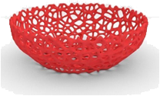
Terminology
Low-Poly
Models created with low polygon counts for artistic effect or speed of rendering
Photogrammetry
A fully textured 3D model created from a series of photographs of a real object
Rigged Model
The process of making an object ready for animation where there is an internal structure coordinated with the mesh surface that can mimic natural movements
Voronoai Model
A model in which only the interconnecting edges of the surface mesh are printed
Note: Derived from more extensive glossary at http://www.brianschrank.com/2730/maya/3dglossary.pdf and elsewhere.

